Slide 1
A Chat on Continual Learning
Nic5472K To members of OHIOH

Slide 2
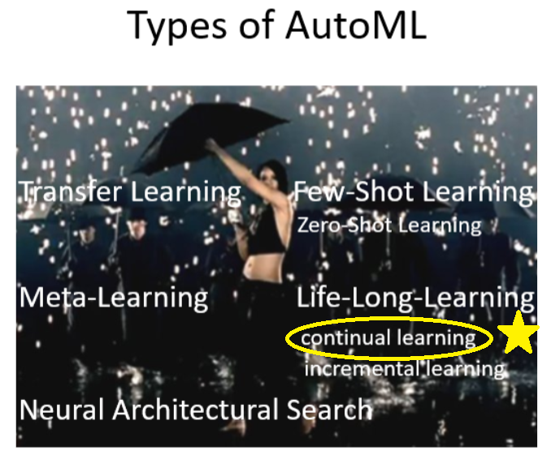
Continued from Last Time
We will focus on Continual Learning

Slide 3

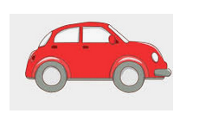


Thought Experiment
Car driving $→$ Cake baking
Forget ?
Source: https://in.pinterest.com/pin/771593348642021179/ https://www.pinterest.com.au/pin/105342078772960869/ https://www.vectorstock.com/royalty-free-vectors/forget-cartoon-vectors

Slide 4

Why Train a Machine Several Skills?
To easily automate machine learning
Optimise decisions in real time
Employ networks in a dynamic environment
Adapt to a stream of information
Storage constraints
Personalise information
Source: https://cn.depositphotos.com/vector-images/rose.html

Slide 5
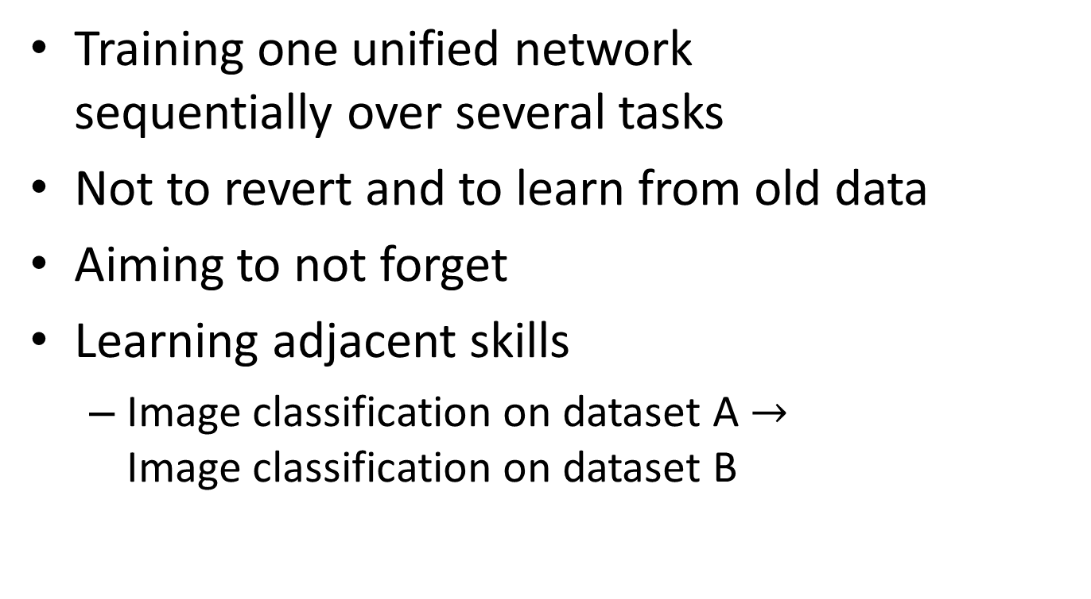
Defining Continual Learning in ML
Training one unified network sequentially over several tasks
Not to revert and to learn from old data
Aiming to not forget
Learning adjacent skills
Image classification on dataset A $→$ Image classification on dataset B

Slide 6
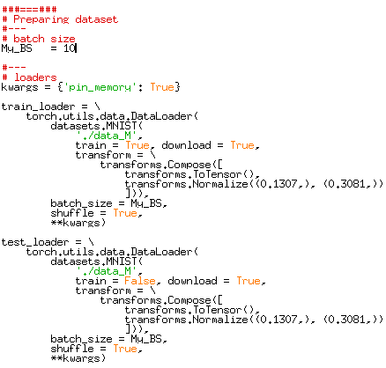
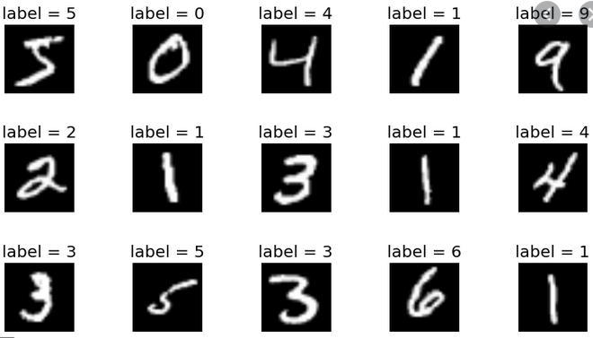
Diving into the Experiments Part1
Dataset: MNIST
Greyscale, 10 classes
28 x 28
Train:Test = 60,000:10,000
Source: https://towardsdatascience.com/improving-accuracy-on-mnist-using-data-augmentation-b5c38eb5a903

Slide 7
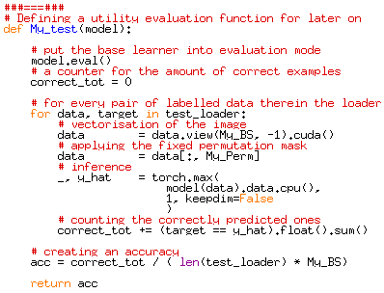
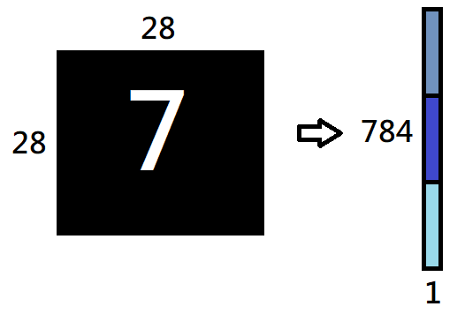
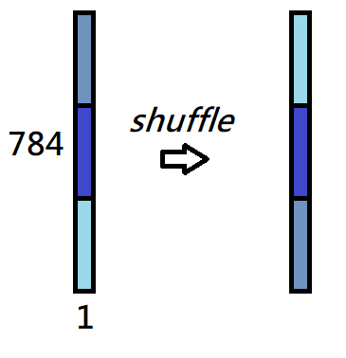
Diving into the Experiments Part2
Task Definition: Permuted Pixel MNIST
Pixel Vectorisation
Permutation Mask

Slide 8
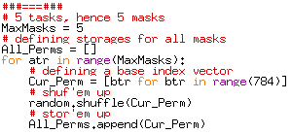
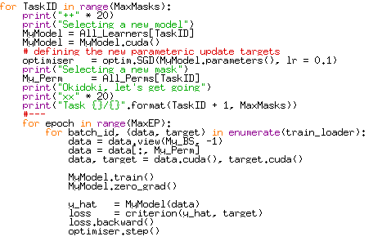
Diving into the Experiments Part3
Clarifying the Masking Mechanic
(1) Masks are created randomly
(2) Fixed, stored, and reused

Slide 9
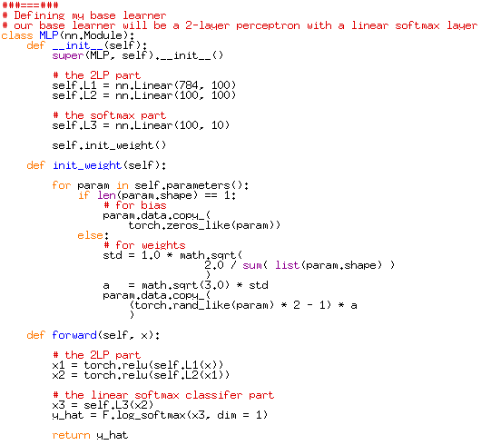
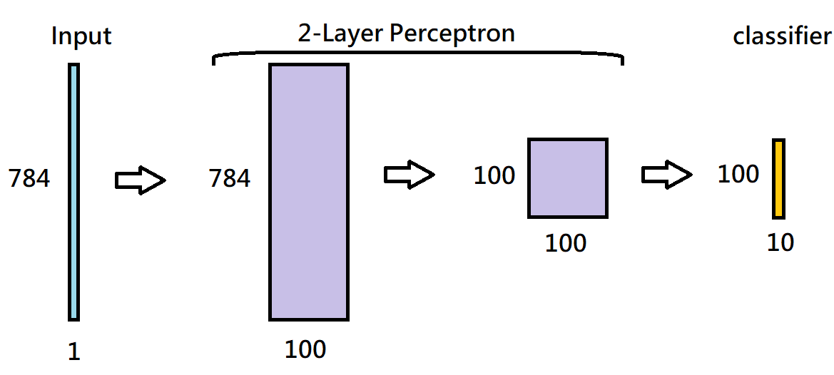
Diving into the Experiments Part4
My ground employed base learner: MLP

Slide 10
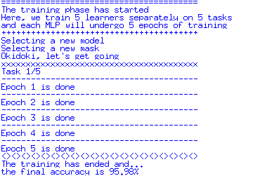
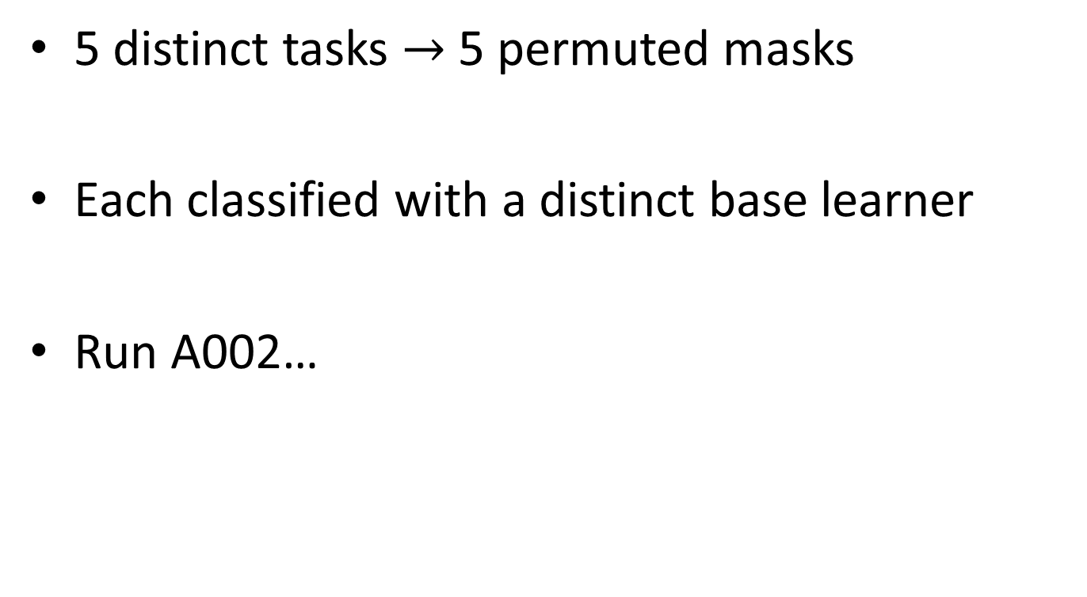
The Traditional ML Setup
5 distinct tasks $→$ 5 permuted masks
Each classified with a distinct base learner
Run A002…

Slide 11
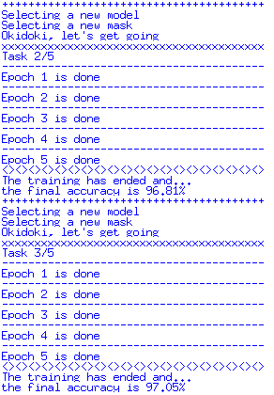
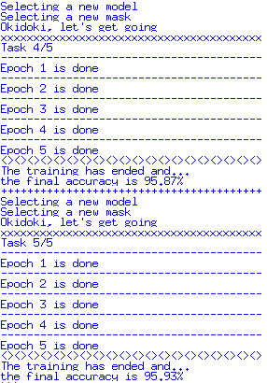
Good Results for Single Task Single Model

Slide 12
Continual Learning Setup
Define only 1 base learner
Sequentially learning to classify different masked representations
Run A003 …

Slide 13
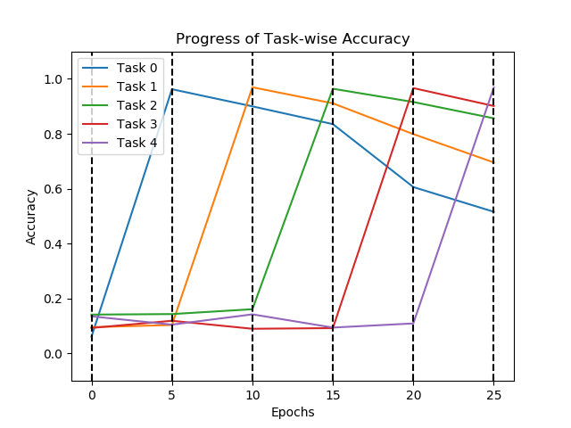
Catastrophic Forgetting

Slide 14
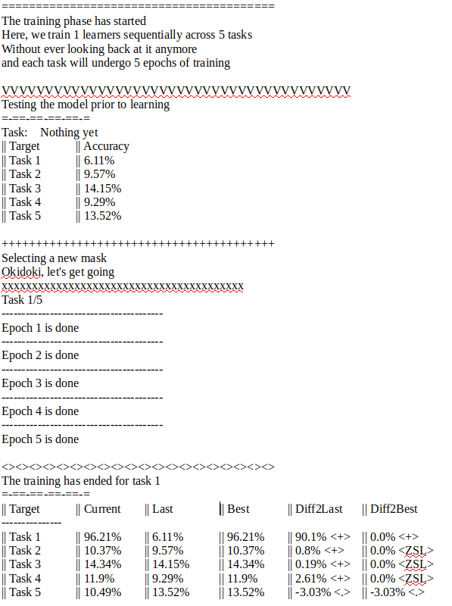
Outputs of A003 Part1

Slide 15
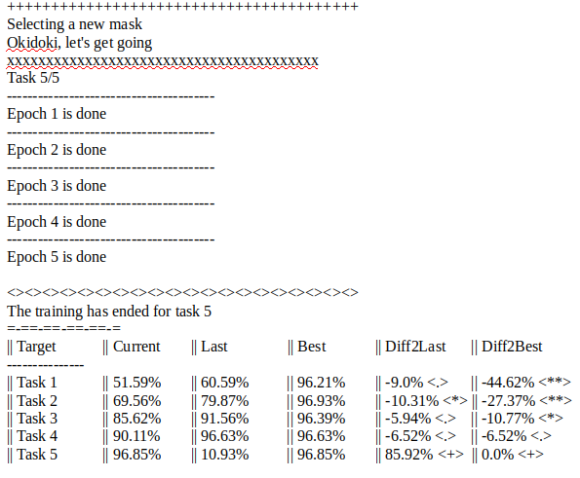
Outputs of A003 Part2

Slide 16
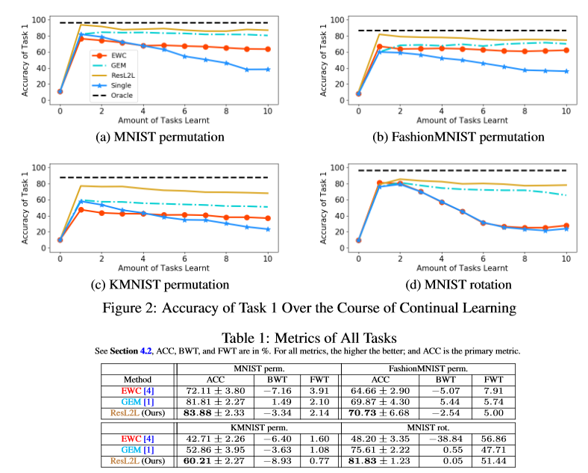
Existing Techniques

Slide 17
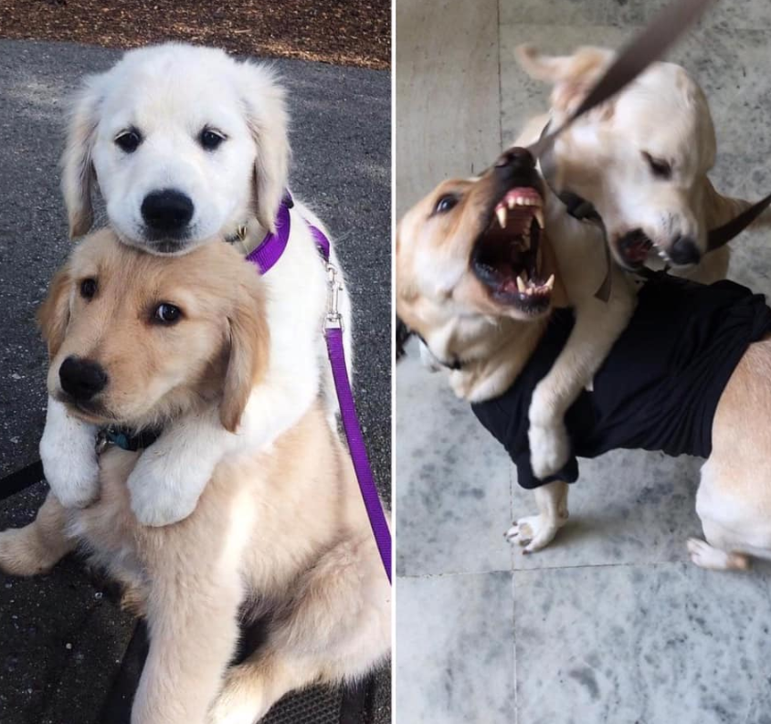
Questions?
Time to rejoice over cute puppies
Source:
https://www.facebook.com/photo.php?fbid=10158165904830469&set=gm.743501793132215&type=3&theater&ifg=1

